Slide 1
A New Age of Identity Fraud
Kyle Esala – FAST Identity Verification Services

Slide 2
Agenda
Identity Theft Statistics
Data Breaches
2022 in Review
$1,400 Returns/Multi-State Migration
Burst Fraud
Recap

Slide 3
Identity Theft (2018)
Type of Identity Theft | Number of Reports | % of Total Top 5
Credit Card Fraud—New Accounts | 130,928 | 40.5%
Miscellaneous Identity Theft | 87,765 | 27.1%
Tax Fraud | 38,967 | 12.0%
Mobile Telephone—New Accounts | 33,466 | 10.3%
Credit Card Fraud—Existing Accounts | 32,329 | 10.0%
Total, Top 5 | 323,455 | 100.0%

Slide 4
Identity Theft (2019)
Type of Identity Theft | Number of Reports | % of Total Top 5
Credit Card fraud—New Accounts | 246,763 | 45.7%
Miscellaneous Identity Theft | 166,875 | 30.9%
Mobile Telephone—New Accounts | 44,208 | 8.2%
Business or Personal Loan | 43,919 | 8.1%
Auto Loan or Lease | 38,561 | 7.1%
Total, Top 5 | 540,326 | 100.0%

Slide 5
Identity Theft (2020)
Type of Identity Theft | Number of Reports | % of Total Top 5
Govt Benefits Applied for or Received | 406,375 | 27.6%
Credit Card Fraud—New Accounts | 393,207 | 26.7%
Miscellaneous Identity Theft | 353,152 | 24.0%
Business or Personal Loan | 204,967 | 13.9%
Tax Fraud | 113,529 | 7.7%
Total, Top 5 | 1,471,230 | 100.0%

Slide 6
Identity Theft (2021)
Type of Identity Theft | Number of Reports | % of Total Top 6
Govt Benefits Applied for or Received | 395,948 | 24.8%
Credit Card Fraud—New Accounts | 389,737 | 24.4%
Miscellaneous Identity Theft | 377,102 | 23.6%
Loan or Lease Fraud | 197,914 | 12.4%
Bank Fraud | 124,388 | 7.8%
Employment or Tax-Related Fraud | 111,723 | 7.0%
Total, Top 6 | 1,596,812 | 100.0%

Slide 7
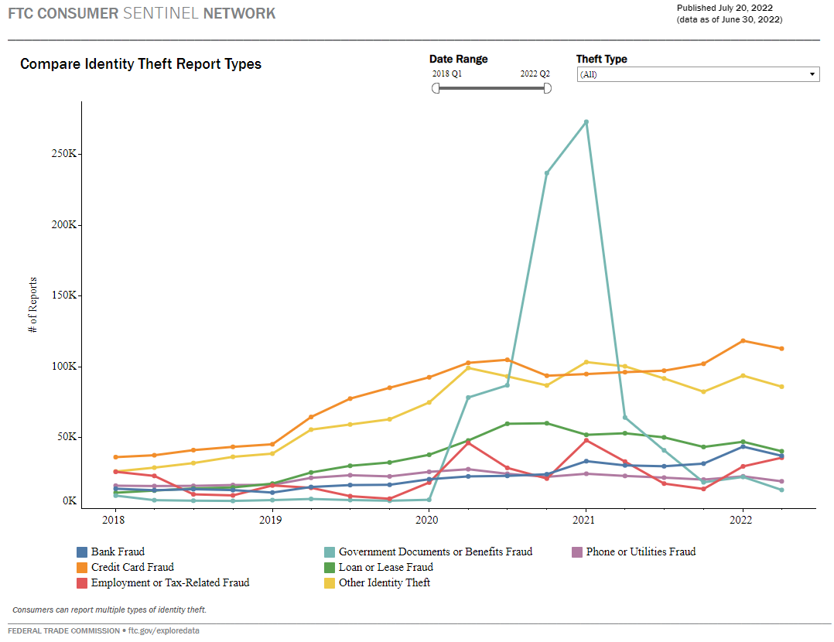

Slide 8
Data Breach Statistics Over Time
Notes:
Source: Statista

Slide 9
Data Breaches in 2021
Facebook
When: April 2021
LinkedIn
ParkMobile
When: March 2021
What: 533 million FB users contact details. Usernames, names, residences, dates of birth, and emails
How: Facebook officials stated that the data was stolen due to a flaw that the social media company remedied in 2019.
When: June 2021
What: 700 million users’ emails, names, numbers, usernames, social and work experience, and other online accounts.
How: The intruders “scraped” the data by abusing the API.
What: User data such as license plate numbers, email accounts, contact numbers, vehicle names and mailing addresses
How: Cybersecurity problem involving a flaw in software the company uses.

Slide 10
Have you been impacted?
Go to haveibeenpwned.com and enter your email address or phone number.
Who has been involved in the most breaches?
What type of data was leaked?
Anyone not in a breach?

Slide 11
2022 In Review

Slide 12
2022 Schemes
$1,400.. $1,400.. $1,400
Multi-State Migration
“Burst” Fraud

Slide 13
$1,400 Federal Refund Fraud Stats
Total Returns
State Refunds
Federal Refunds
165,000
$17 million
$316 million
1,000 to 100,000 Per State

Slide 14
What to look for: $1,400 Fed Refund Fraud
$1,400 Federal Refund (or very close)
Filing Gap
OR
FTF
MeF
DOBs
Earlier than 1960
OR
Later than 2000
Routing Numbers: Metabank, Green Dot, Sutton, Republic Bank, Discover Bank
Email Domains: aol.com, hotmail.com, outlook.com, gmx.com, mail.com
$0 State Refund
OR
State refundable credits
$0 AGI
$0 Wages
$0 Withholding
No Preparer

Slide 15
Multi-State Migration: $1,400 Timeline

Slide 16
$1,400 Returns – FIVS Demo

Slide 17
Burst Fraud
Waves of fraudulent submissions in short periods
Typically follows “Poke & Prod” efforts
Sometimes easy to spot, sometimes not.
Can be drowned out in larger volume days

Slide 18
“Coordinated” Efforts…

Slide 19
What to look for: Burst Fraud
FAGI, Withholding, Refund Amounts
TOR – Tor Exit Nodes
VPN – Anonymous Location
PUB – Public Proxies
SES – Web Scraping Bot
Green Dot
Metabank
Sutton
123456
0123456
00123456
000123456
Keith Johnson – johnkeit@gmail.com
Steve Thompson – thomstev@gmail.com
Anna Smith – smitanna@gmail.com
yopmail.com
getnada.com
mailnesia.com
“whois” registration info
DOBs in small ranges
joeschmoe@gmail.com
joe.schmoe@gmail.com
j.oeschmoe@gmail.com
j.o.e.s.c.h.m.o.e@gmail.com
Use doc rules to find changes to key fields
Bank Leading Zeros or Digits
Prepaid Banks
Duplicate Currency Amounts
Proxies and VPNs
Identity Cycling
Email Duplicate Tactics
Email Username Structure
Disposable Emails
Email Domains
DOB/Routing # Patterns

Slide 20
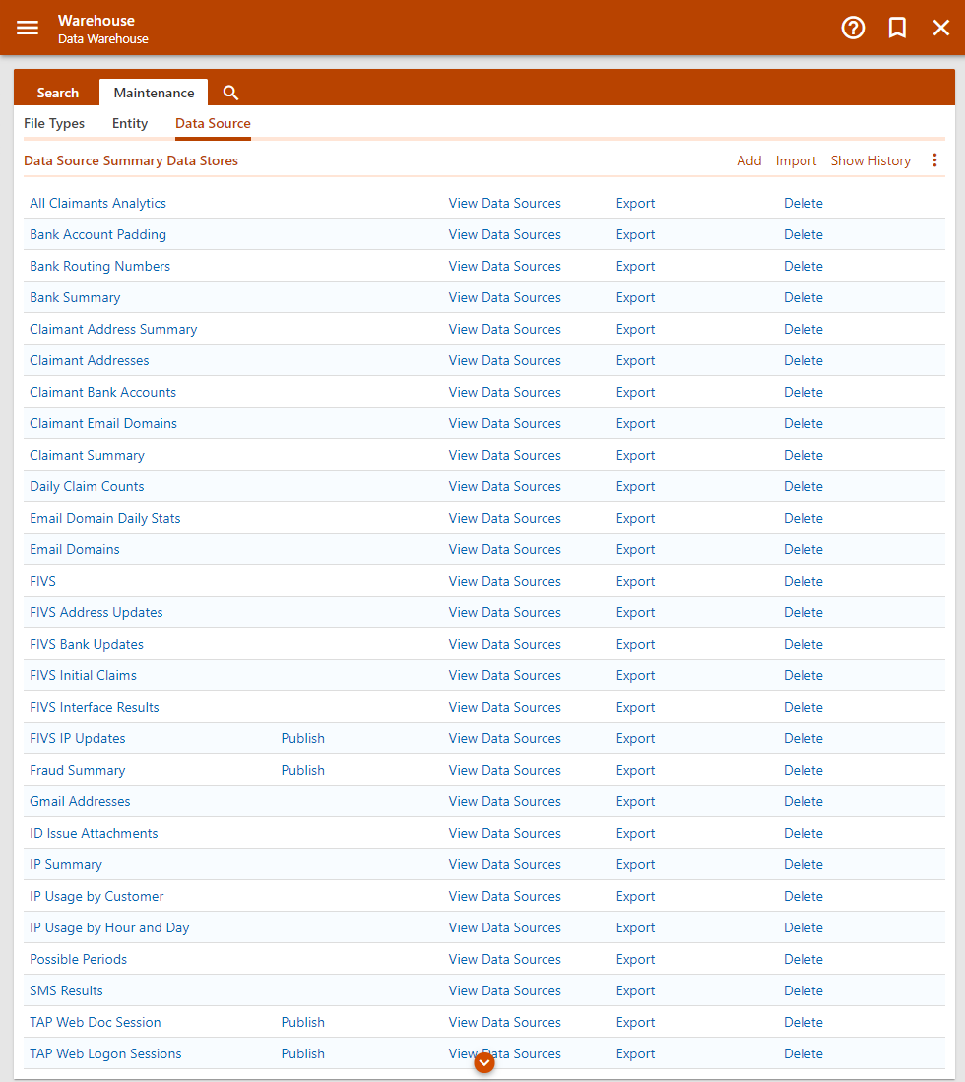
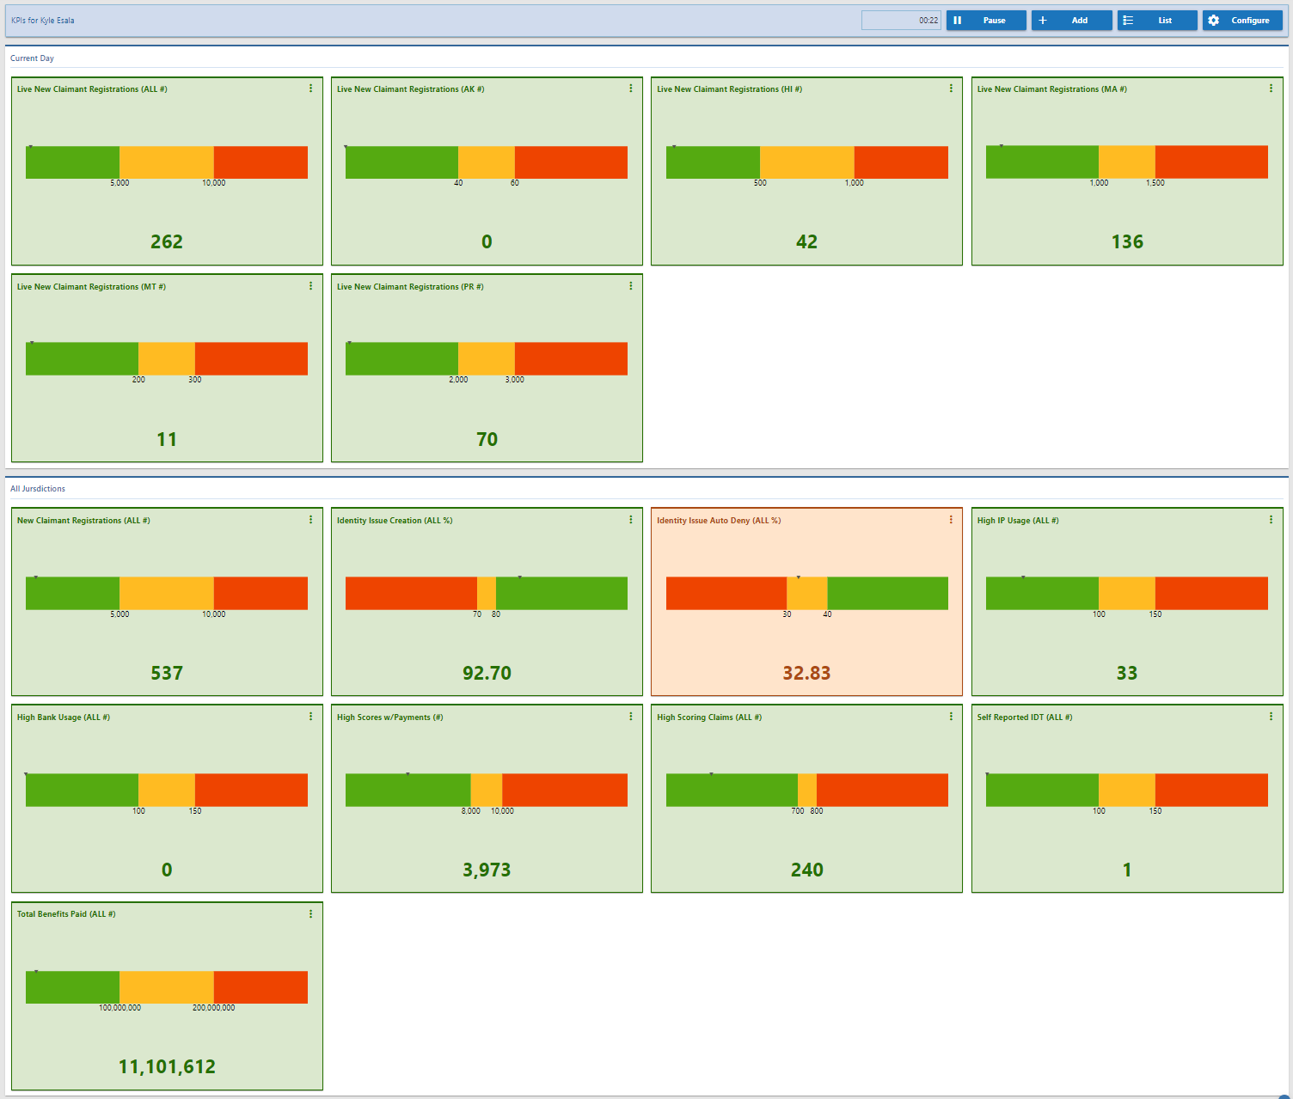
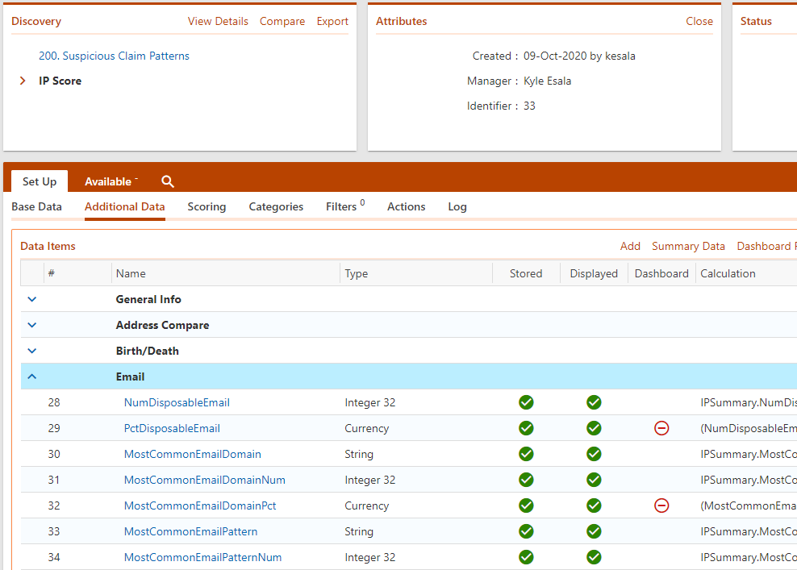
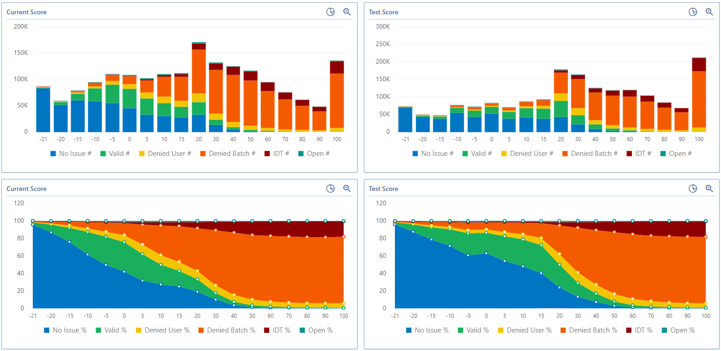
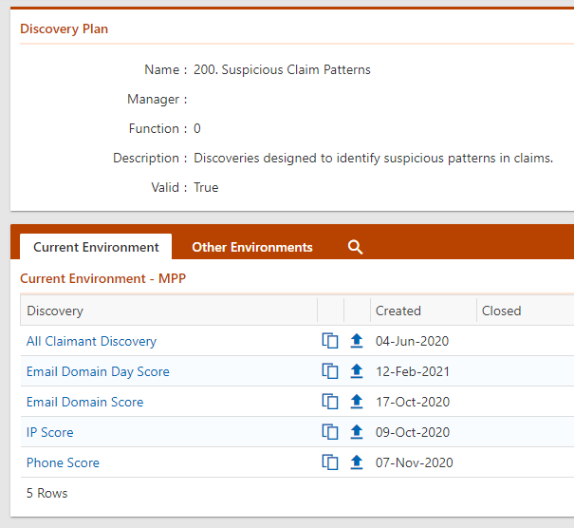
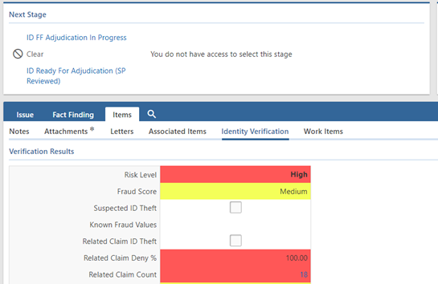
Tools You Can Use
Fraud Manager
Discovery
Warehouse
Data Cubes
Ad Hoc Queries
KPI*

Slide 21
Burst Fraud – FIVS Demo

Slide 22
Recap
Next Year
More scrutiny needed on PY matches
Need a more comprehensive plan
DATA IS KING
Share, Share, Share
Operating in a “silo” is no longer adequate
Fraudsters are sharing & we need to as well
In the spirit of sharing…
Pre-prepared queries available to look for similar patterns
Pre-prepared lists of suspect IPs, email domains, & routing numbers
Reach out to kesala@gentax.com if interested in receiving

