Slide 1
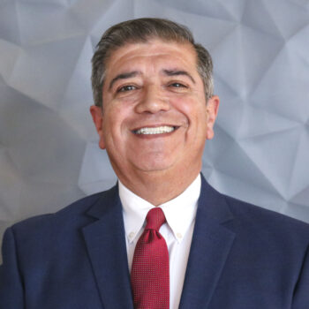
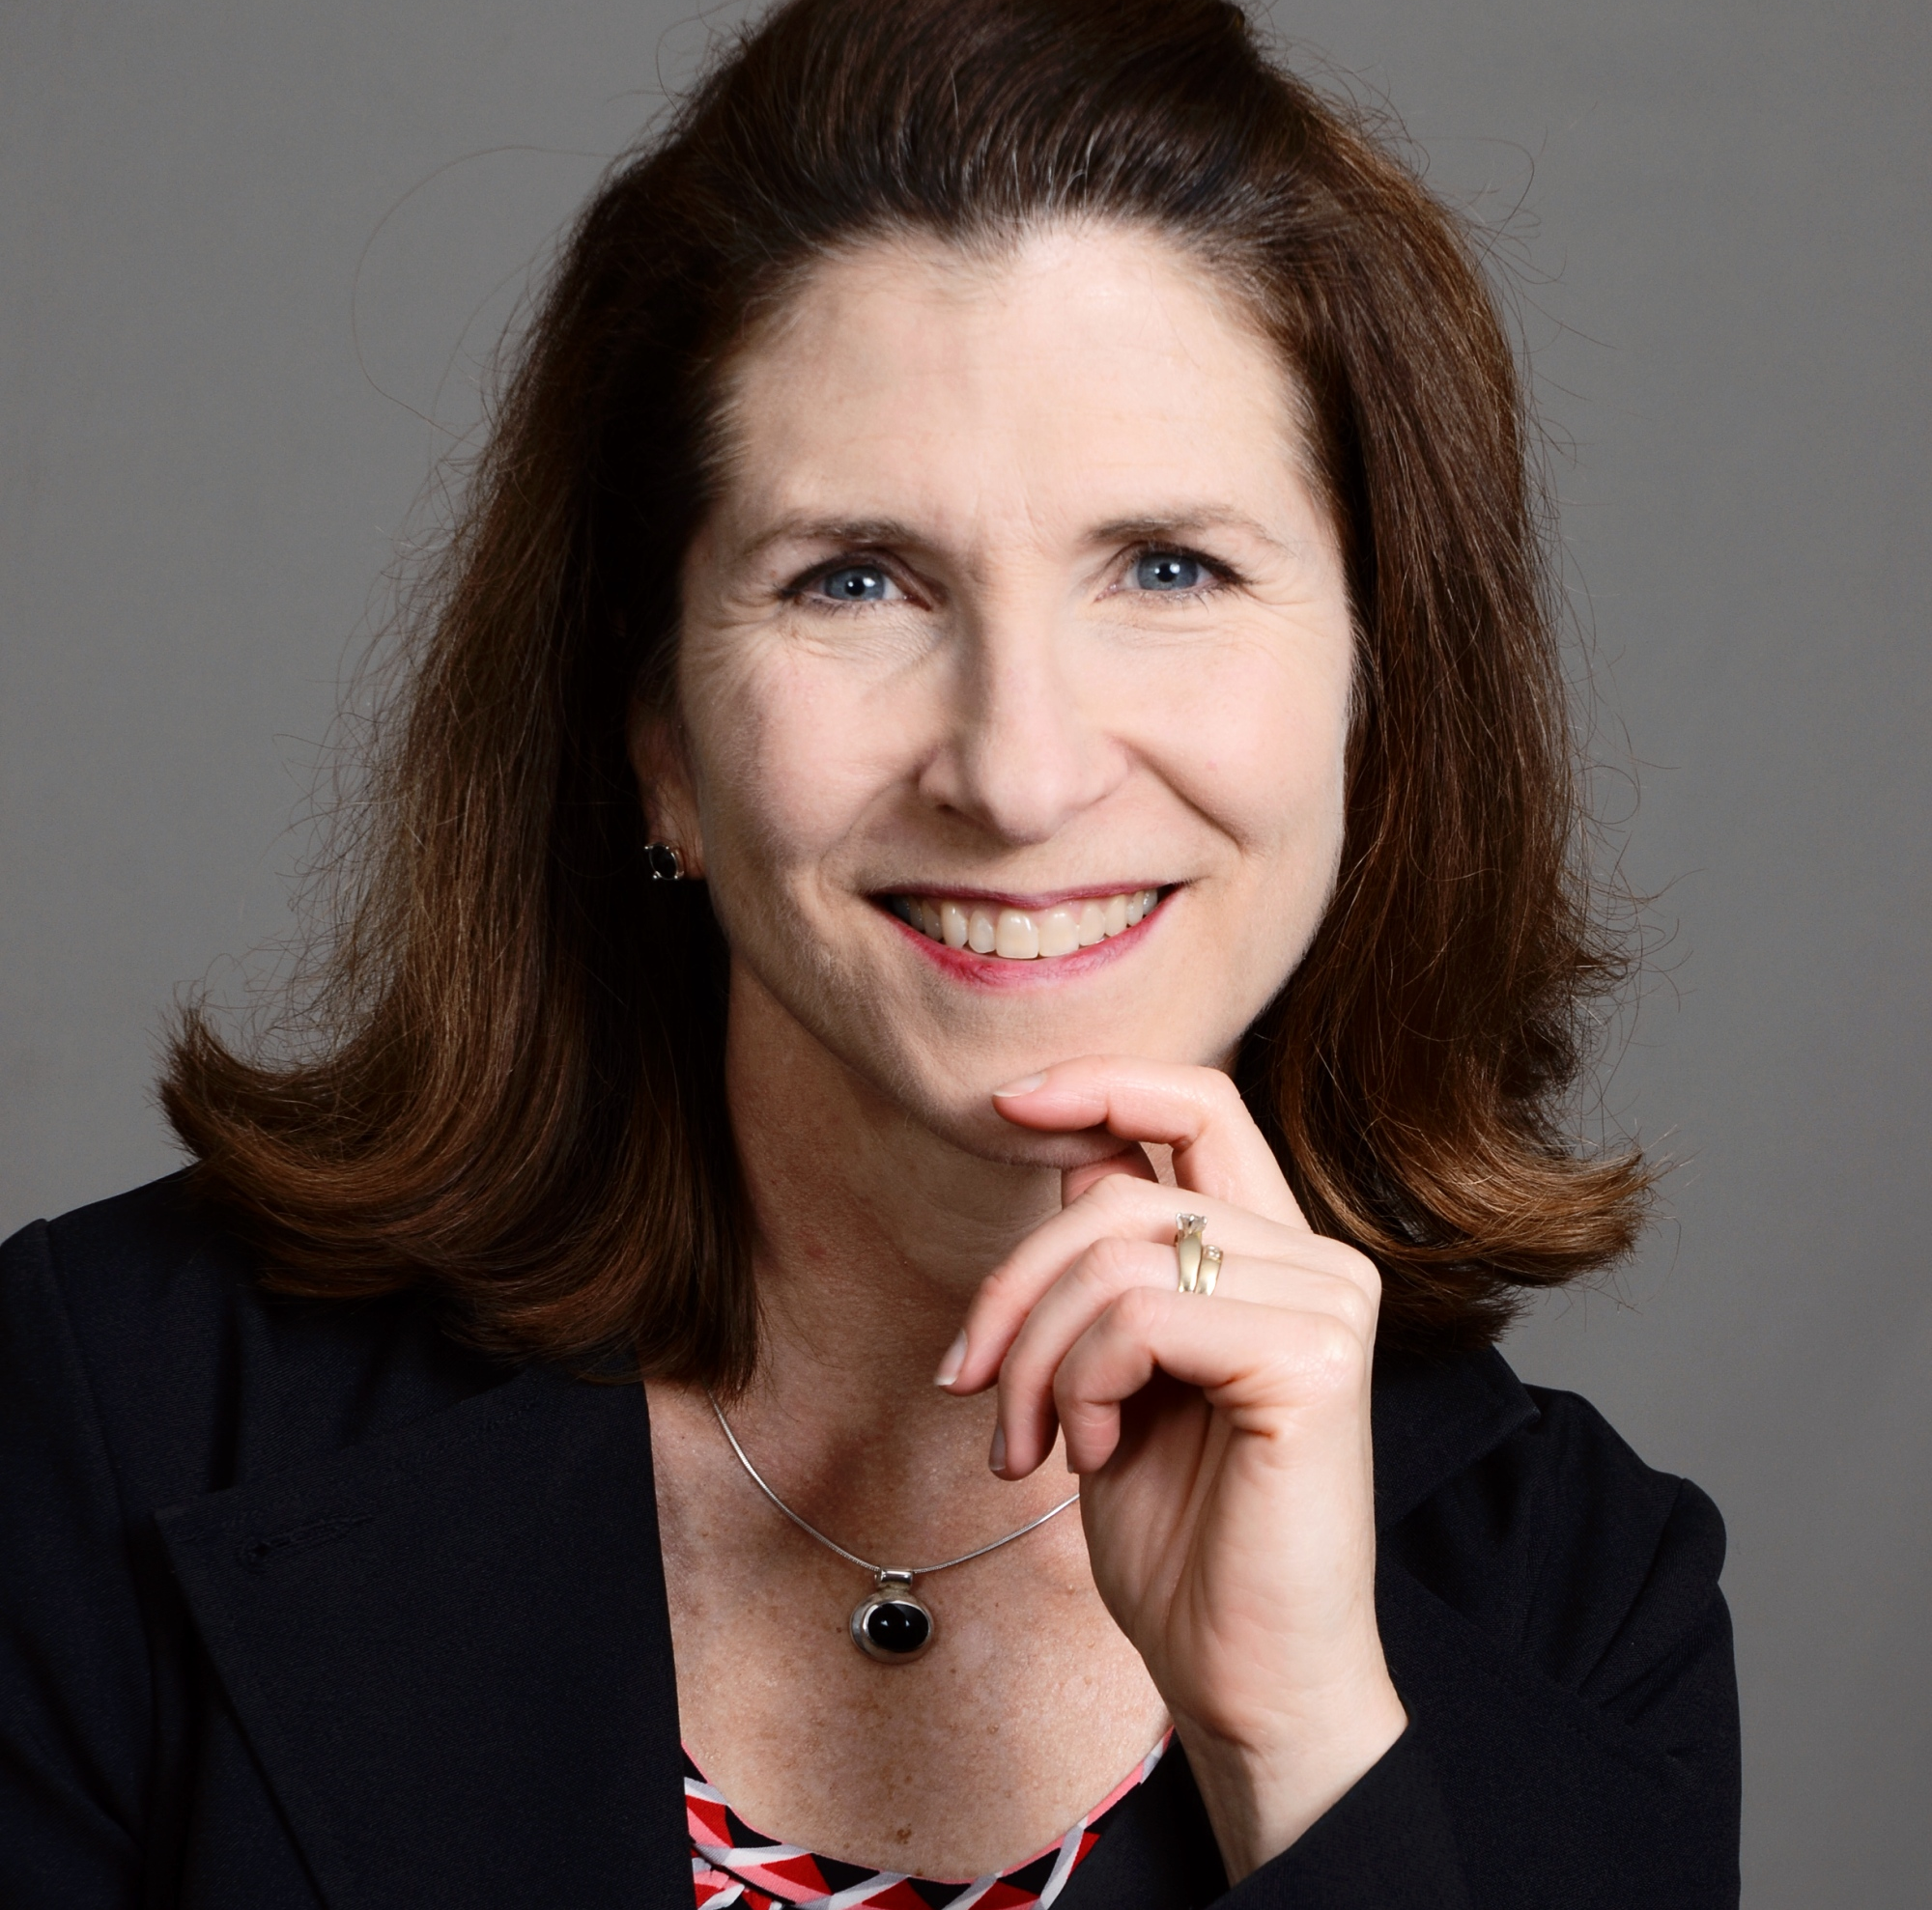
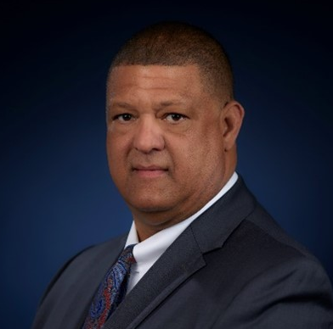
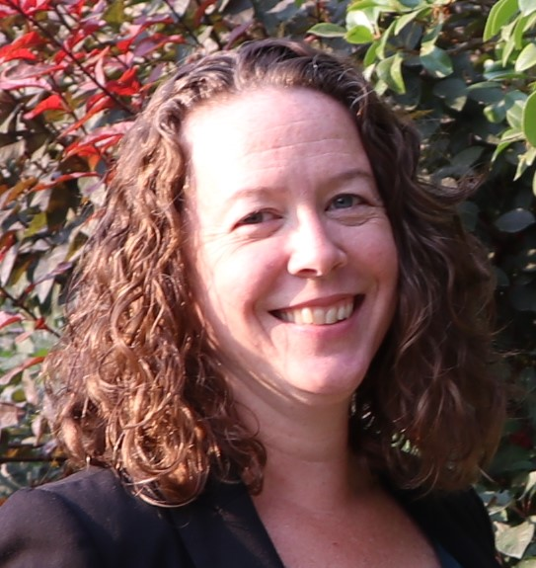
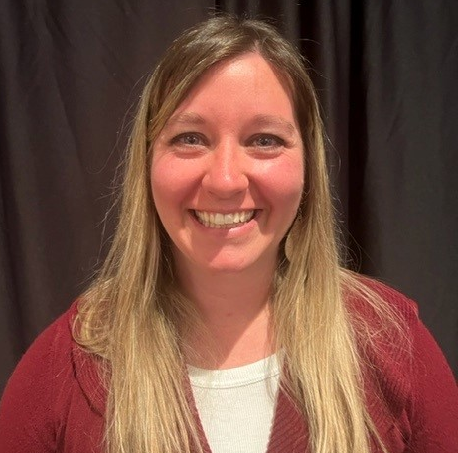
Introductions: Compliance Programs Panel
John Vecchiarelli
Mary Mosiman
Dale Simpson
Christen Lewis
Danielle Pennington

Slide 2
Compliance Panel- General Session
Hello everyone, It is so good to see all of you live and in person at this the first live FAST Compliance Conference since February of 2020.
I am happy to see you, but I must admit to a little disappointment that I seem to have aged more rapidly than the rest of you during this period of time.
For those who don’t know me my name is John Vecchiarelli and I work for FAST in Client Support

Slide 3
Introduce the Panelists
I am joined today by:
Christen Lewis is the Fraud and Criminal Investigation Unit manager at the Idaho State Tax Commission
Mary Mosiman is a Deputy Director and the Tax Management Administrator in the Iowa Department of Revenue
Danielle Pennington is the Collections Bureau Chief from Montana,
And Dale Simpson is currently the Deputy Secretary for Compliance and Collections for the Pennsylvania Department of Revenue.
Today we will be exploring the current state of compliance programs at these Client Sites, and we will talk a bit about how they have evolved their compliance programs to keep pace with our everchanging world.

Slide 4
Panel Questions
I am going to begin by asking each panelist to respond to my opening question and my final question, but apart from those 2 questions our discussion will explore specific compliance activities in these states.
2-Part Question for all: Did your agency suspend Compliance Activities in response to the Pandemic, if yes, for how long? Did your agency change its Compliance philosophies as a result? Each panelist responds.
Dale lets start with you sir; How did Pennsylvania react at the start of the pandemic in regard to your compliance activities? If you suspended them, for how long and where did your agency end up philosophically in relation to tax compliance programs?
Danielle how about Montana?
Christen what about Idaho?
And last but certainly not least, Mary how did Iowa react?

Slide 5
Panel Questions-Page 2
Thank you, panelists, that was very enlightening. It is hard to believe that it has been almost 3 years since our world took a dramatic change. However, it is gratifying to see that we humans are starting to figure out what our world will look like in the future.
Okay I’d like to begin by asking Christen, who represents Idaho, our longest standing US client a question. Christen, I read about Idaho’s Revenue department taking on new duties during the pandemic, in terms of administering benefits distribution programs that have never previously been done by the department. Can you tell us a little about that? How did it come about? Did you learn things along the way? Did your use of FIVS improve benefit distributions?

Slide 6
Panel Questions-Page 3
Thank you, Christen. It sounds like your agency was essential in ensuring that the pandemic relief funds reached to proper people and organizations. So, does this mean that citizens now revere and respect the Idaho DOR?
Mary, I realize that your agency began and implemented GenTax during the work from home limitations. Did that fact cause you folks to look differently at what a post pandemic compliance environment might look like? I also know that creation of and an expanded use of a Business Portal was one of your governor’s priorities. I assume that there was some synergy created through the governor’s goal and the work from home limitations. Please describe in some detail what type of actions a business taxpayer can now complete online?

Slide 7
Panel Questions-Page 4
That is very interesting Mary. How has your agency staff reacted to these changes? Have you noticed any changes in taxpayer behavior?
Danielle, I know that Montana recently implemented a Recreational Marijuana Tax, I also know that Montana is to my knowledge the only state that is using GenTax for both tax administration and licensing. Can you tell me a little about how that decision came about? Was it simply a cost decision?

Slide 8
Panel Questions-Page 5
As you may know Colorado and Washington legalized on the same day in January of 2014. I was still the director then, so I have an interest in how other states approach legalization.
Dale, I have been informed that your project was also implemented during the Work from home limitations. I read that Pennsylvania has embraced the idea of self-serve payment plans. Can you tell us a little bit about that? Who qualifies? How do they avail themselves of this option? Have you received any pushback from collectors?

Slide 9
Panel Questions-Page 6
Dale I am a firm believer in allowing every taxpayer the benefit of the doubt, remember they are not willing customers, they are a captive audience, so whenever possible I believe in second chances and these payments plans do just that.
Mary, can you tell me has having an Integrated Tax system provided any efficiencies? For example, has training of employees become any easier? How about maintaining policies and procedures? Did the project provide decision makers with the time and incentive to re-evaluate how you do things?

Slide 10
Panel Questions-Page 7
I think back to when we went live with GenTax in Colorado, it was one of my most worthwhile accomplishments and it changed the way we administered taxes forever. I offer my sincere congratulations on your successful project.
Christen, Idaho is one of my client sites and I know that you folks have been automating many things recently, especially in Compliance. Please take a few minutes and tell us about what things you have automated and why you decided to automate this activities.

Slide 11
Panel Questions-Page 8
Christen, was making things easier for the taxpayer one of the goals of your automation efforts or was it focused primarily on employee workload reduction?
Danielle, Communicating clearly and making it easy for taxpayers to comply is a win/win for both the agency and the taxpayer. Allowing taxpayers to do more online, reduces errors and frees up staff time for higher value activities. Can you tell us is Montana attempting to leverage more e-Service options?

Slide 12
Panel Questions-Final Page
Danielle, I think that most taxpayers want to be compliant but that they are not tax experts, did you get any positive feedback from citizens about e-Services?
Dale, can you tell us is Pennsylvania considering the use of FAST Collection Services? Has your agency developed a vision for your analytics-assisted collection strategies? Do you know which FCS strategies you will implement?

Slide 13
Panel Questions-Final
Thank you, Dale that is very interesting, and enlightening.
The final question that I have for each of our panelists is:
Does your agency have any new, unusual, exciting or interesting compliance programs that you are considering or in the process of developing?

Slide 14
Closing Comments
That concludes our panel discussion, please join me in thanking our panelists.
If time permits, we may do a quick Audience Q&A

Slide 15
Bonus Questions-If Needed
Danielle Pennington. As bureau chief of Collections have you introduced any other enhancements that you want to mention? You have described easier customer access to self-serve online and more clear language when communicating with taxpayers. How about for staff have you made any changes that make their work more efficient?
Mary Mosiman. Has working with FAST enabled your state to work more effectively for Iowa taxpayers? If yes, please share some of your insights with us.
Christen Lewis. I understand that your site changed by adding a new letter prior to the filing of a lien or enforced collections. Can you please explain the reasons why and has the outcome been as anticipated?
Dale Simpson. Dale, I have been told that PA has used Outside Collection Agencies for some time now, did your agency change its philosophy in regard to the use of these agencies? For example, do you now place delinquencies sooner or do you keep them inhouse longer than you did previously?

