Slide 1
Revitalizing your Audit Program

Slide 2
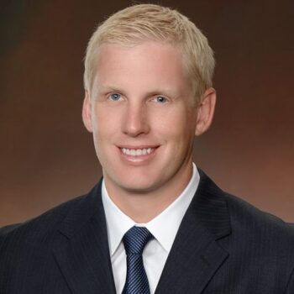
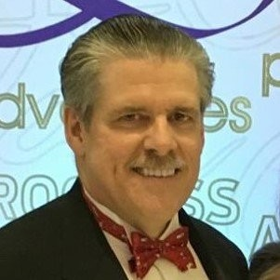
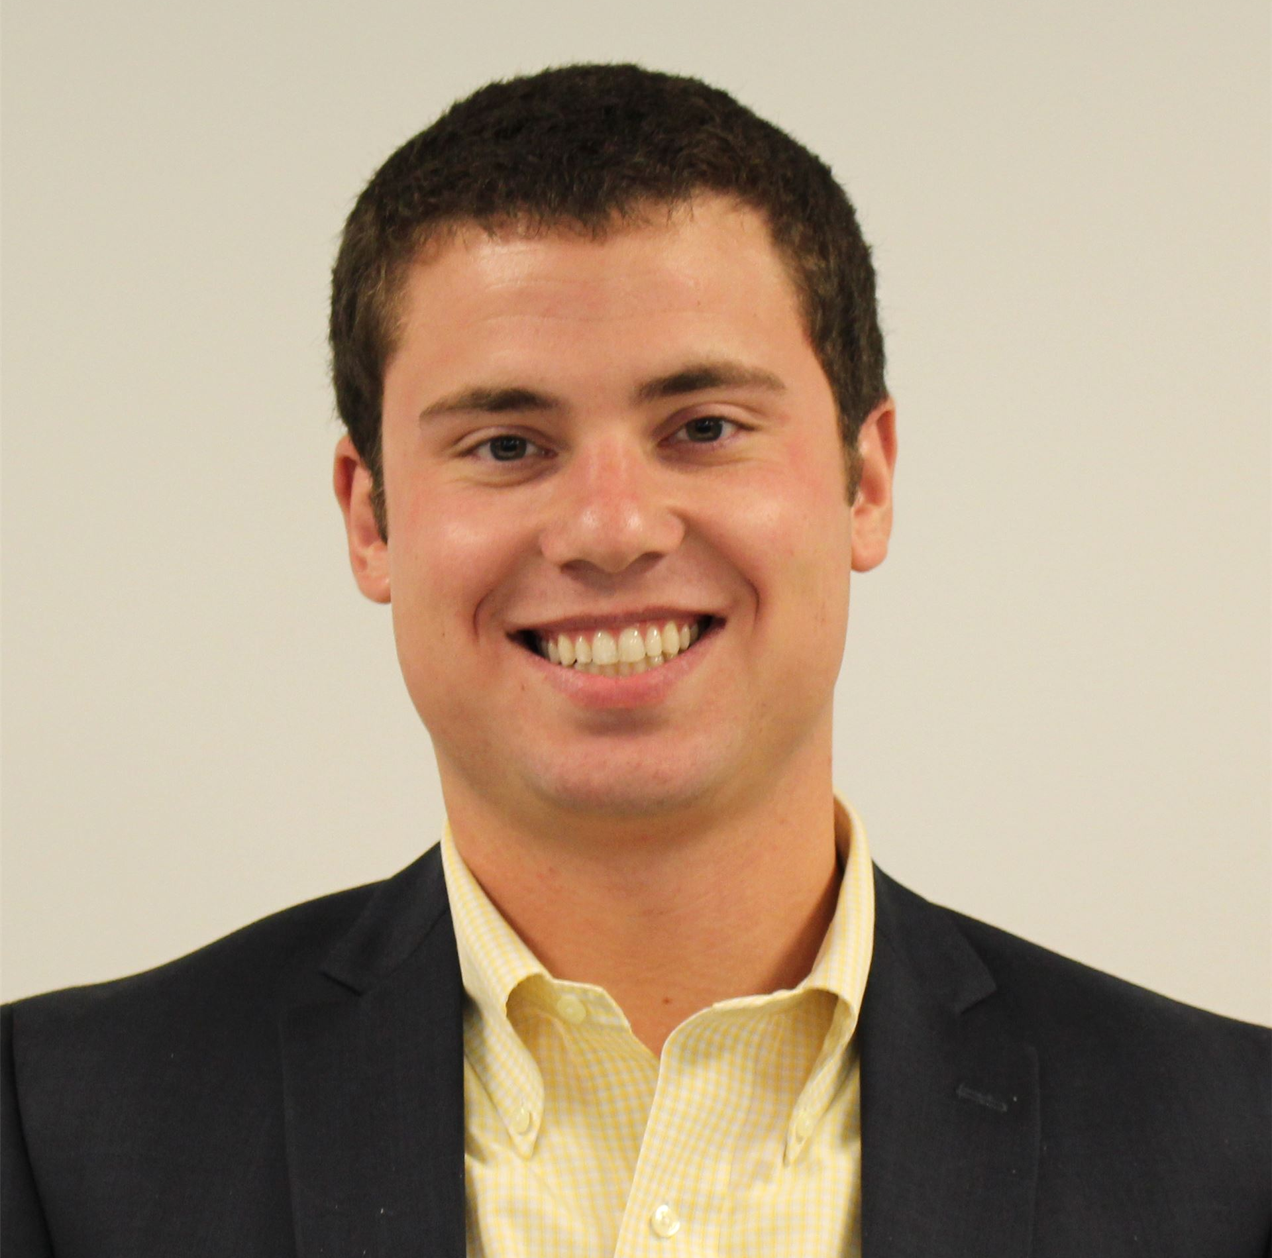
Introductions: Audit Breakout
Josh Decker
Nonie Manion
Andrew Smith
Benjamin Carlson
James McAndrews
Nathan Shagam

Slide 3
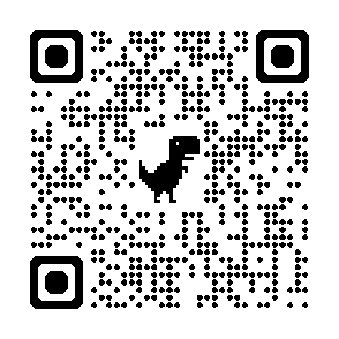
Scan QR Code:
Or Respond to:
pollev.com/acheetah370
Or Text:
ACHEETAH370 to 37607

Slide 4
Notes:
Poll Title: Do not modify the notes in this section to avoid tampering with the Poll Everywhere activity. More info at polleverywhere.com/support Submit your questions for the panelists. https://www.polleverywhere.com/free_text_polls/aIz1yAT315e5zgnCc9Cll

Slide 5
What is new in Audit?
Josh Decker – FAST Director

Slide 6
Audit Trends
- Better reporting
- Audit workflow enhancements
- Self-service/virtual audit
- Moving the audit up (“pre audit”)

Slide 7
Leading the Change
Andy Smith
Benjamin Carlson
Jim McAndrews
Nathan Shagaw

Slide 8
Audit Program Project
SCDOR – DORWAY Project

Slide 9
What we needed in South Carolina
Consistency
Efficiency
Flexibility

Slide 10
Consistency
Staging
Expanded the staging process for audits within our system
Stages that were previously done outside the system have been brought in
Interview
Converted the interview from paper to digital
Required questions
Toolkit
Required line by line guidance for tax forms
Assists with completing an audit
Specific to each industry or schedule
Context Help
Relevant help articles that are easy to access

Slide 11
Context Help
Example: Help has checklist of work to be done.

Slide 12
Context Help – Sales Pre-Audit Checklist Example
Business enters and updates text – no SQR required.
Sales Pre-Audit Checklist
** These are suggestions for pre-audit review
For Question 1:
Compare gross receipts on the income return (1120, 1120S, 1065, Schedule C) to ST-3 gross sales
Compare COGS on the income return to reported gross sales
Review depreciation forms and/or balance sheet comparisons on the income return to identify any large asset purchases
Review taxpayer’s filing history
Review related tax accounts (Admissions, Liquor by the Drink). If LBD is present, compare Sales to LBD.
Review deductions (run Sales Reductions Summary report)
Check the company’s website, Facebook, and reviews for hours of operation, happy hour info, specials info, proof of admissions being charged, amenities offered, etc.
Read notes in DORWAY, Power of Attorney info, questions for TAOS, issues with filing history, contact persons listed on the account …

Slide 13
Efficiency
Getting all auditors on the same page
Creating multiple audits from the same lead
Eliminates redundant leads for the same customer
Covering multiple audits with one interview
Enhanced Reporting
With more of the audit happening within the system we have more information to report on

Slide 14
Example Audit Group
Audits assigned to group

Slide 15
Flexibility
Context Help managed by auditors
Can be updated in real time
No waiting for SQRs
Scalability
Starting with these audit types and being able to easily rollout more
Toolkits and Interviews are the bulk of “new” development
Optional review stages
Peer Review
Peer Supervisor Review
Optional additional questions
To record questions that aren’t already in the interview
Reporting on these questions will help to improve interview in the future

Slide 16
Revitalizing Your Audit Program
Jim McAndrews and Nathan Shagam

Slide 17
Determine Metrics by Defining Success
Supplemental Reporting
Supervision
Visualization
Speed
Quality
Balance
Speed & Quality
Results
Notes:
Divide Into Groups: Choose the numbers of groups and evaluate to determine how records are divided into groups
Find Similar Records: Select similar records and evaluate the most similar records not already in the selection
Find Data Anomalies: Find submissions that are most dissimilar in comparison to their peers.
Gain Variable Insights: Gain insights about fields that help predict a selected value.
Find Variable Correlation: Find out which variables are correlated with each other.

Slide 18
DC Audit Revitalization - Education
Define proper audit work
What it should look like
Good and bad
Define proper time reporting
How it should be done
Define proper audit workload
How many should be completed
How many should be worked on
Benefits
Good for everyone

Slide 19
DC Audit Revitalization - Enforcement
Accountability
Enforced through KPIs and select reporting
Top-down analysis
Audit Supervisor to audit stage level
Concrete metrics of issues
"I don't think you're working very efficiently"
Actual data to support these theories
Concrete metrics of success
"We want to work more, better audits"
Attainable, real standards for achieving this

Slide 20
Project Implementation – Keys to Success
Key direction from leadership
Leadership involved in requirements
Well defined
KPIs
Supporting Reporting
Measures of Success
Communication with audit team
Feedback and training
Engaged Development Team
Constant communication
How to best leverage GenTax functionality

Slide 21
Audit KPIs – Phase 1 and 2
Procedural/workflow focused
Audit timeframes
Auditor time reporting
Enforce standardization of procedures
Identify holdups
What areas need training/improvement
Growing pains
Metrics that make sense
Understand "Why?"

Slide 22
Currently Implemented KPIs – Phase 1
Speed
Quality
Management
Average Duration of Open Audits
Percent of Audits That are Overaged
Average Number of Hours Spent on Open Audits
Percent of Open Audits with Acceptable Audit Hours
Average Auditor Review Duration
Average Manager Review Duration
Percent of Audits with Acceptable Auditor Review Duration
Percent of Audits with Acceptable Manager Review Duration
Average Number of Audit Stages
Acceptable Audit Workload
Average Number of Send-Backs to Auditor

Slide 23
Currently Implemented KPIs – Phase 2
Audit Outcome
Percent with RCU Review
Percent that enter Appeals
Percent with executed Consent Agreement
Percent that were reopened
Management
Percent of Supervisors that meet coaching expectations
Opened audits
Posted audits

Slide 24
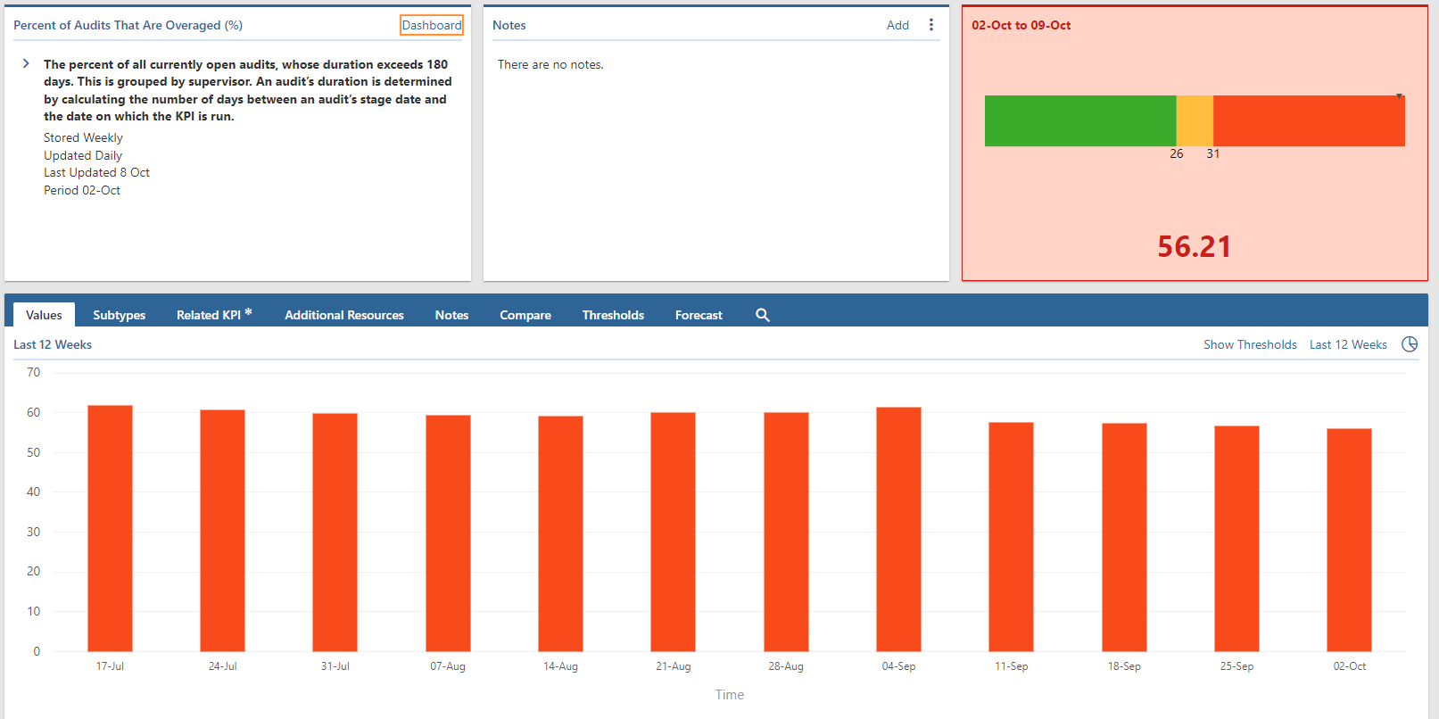
KPI and Supporting Reporting
Example: Audits that exceed 180 days duration
KPI- Explanation
Notes
Current Level
Percent that exceed 180 days over time

Slide 25
KPI and Supporting Reports
Standardized subtypes
Supplemental reporting based off subtypes
Subtype by Supervisor
Data Sources

Slide 26
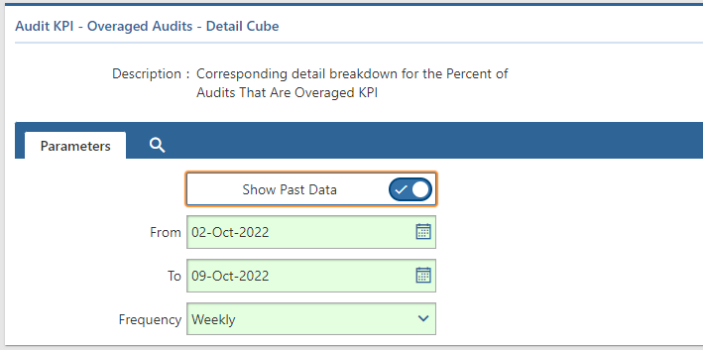
Audit Detail Reporting
Example: Overaged Audits
Customizable timeframes
Current and past data
Visualized KPI value with detail information
Percent of aged audits over time

Slide 27
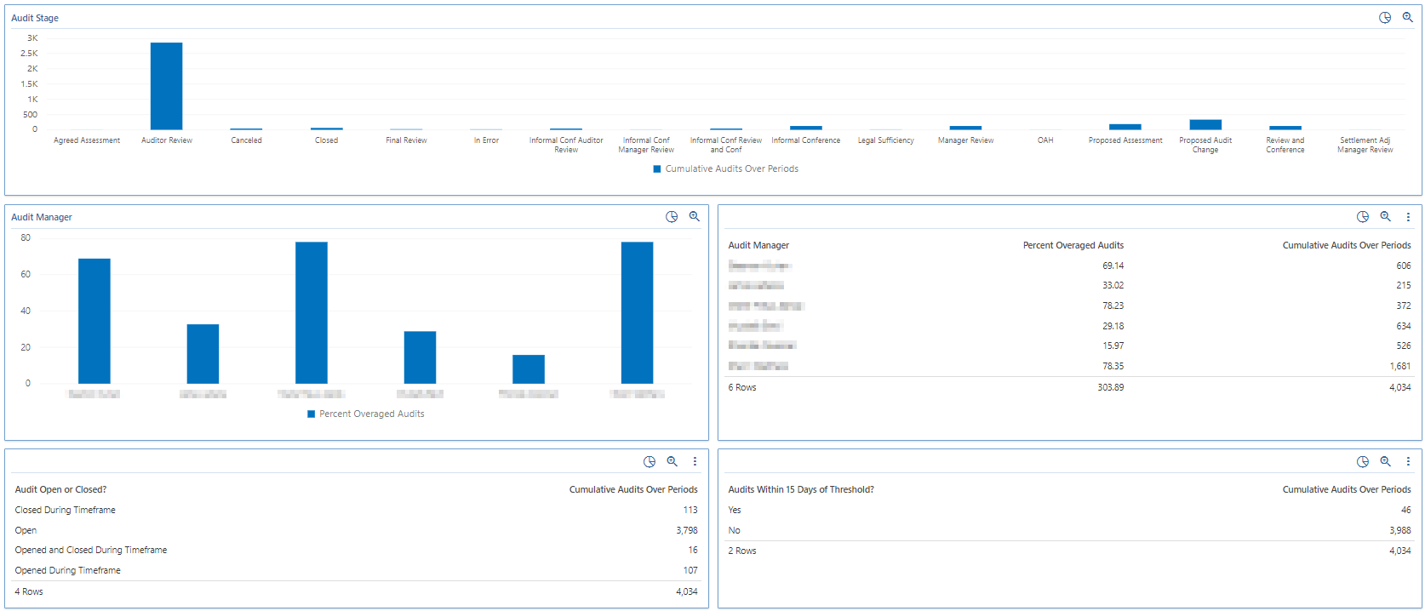
Audit Detail Reporting
By Audit Stages
By Audit Managers
Open and Closed
Nearing Aged Threshold

Slide 28
Audit Detail Reporting
By Auditor
By Audit Type
Individual Audits

Slide 29
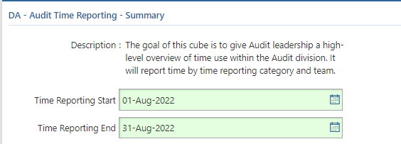
Audit Time Reporting
Defined time reporting goals
Supervisor to auditor accountability
By Team
By Auditor

Slide 30
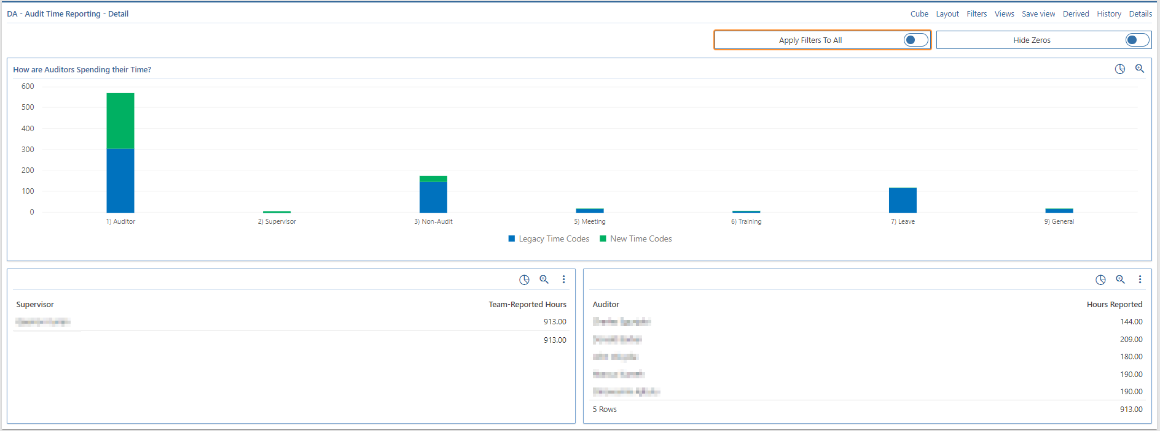
Audit Time Reporting
Supervisor Specific View
How audit team is spending time
Team reported hours
Auditor hours

Slide 31
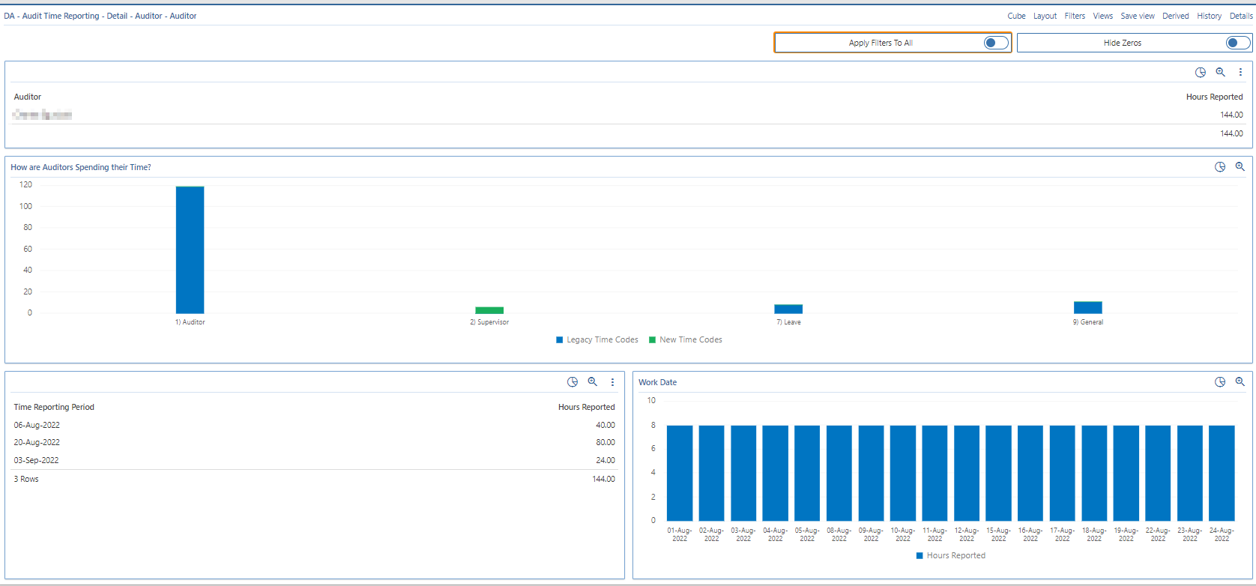
Audit Time Reporting
Auditor specific view
Auditor name and hours
How time is spent
Hours by day
Hours by period

Slide 32
Future Initiatives
Combined KPI reporting
Success at expense of something else
KPI Phase 3
Audit Lead and Assessment KPIs
Audit selection enhancements
Discovery improvements
Business Intelligence selection criteria
Improved reporting

Slide 33
Scan QR Code:
Or Respond to:
pollev.com/acheetah370
Or Text:
ACHEETAH370 to 37607

Slide 34
Notes:
Poll Title: Do not modify the notes in this section to avoid tampering with the Poll Everywhere activity. More info at polleverywhere.com/support Submit your questions for the panelists. https://www.polleverywhere.com/free_text_polls/aIz1yAT315e5zgnCc9Cll

Slide 35
Notes:
Poll Title: Do not modify the notes in this section to avoid tampering with the Poll Everywhere activity. More info at polleverywhere.com/support Biggest challenge in one word! https://www.polleverywhere.com/free_text_polls/FpnPOcDnk0fYlxIeu5m6i

Slide 36
Notes:
Poll Title: Do not modify the notes in this section to avoid tampering with the Poll Everywhere activity. More info at polleverywhere.com/support We would like to start working on the audit program changes .... https://www.polleverywhere.com/multiple_choice_polls/4xIUxLx9zZWg6i8FoSZYQ?state=opened&flow=Default&onscreen=persist

Slide 37
Notes:
Poll Title: Do not modify the notes in this section to avoid tampering with the Poll Everywhere activity. More info at polleverywhere.com/support We would like to start working on Audit KPIs .... https://www.polleverywhere.com/multiple_choice_polls/Q0Hju24PvJsIrM2ZQiyAo?state=opened&flow=Default&onscreen=persist

