Slide 1
Trends in Collections
Collection Breakout Panel

Slide 2
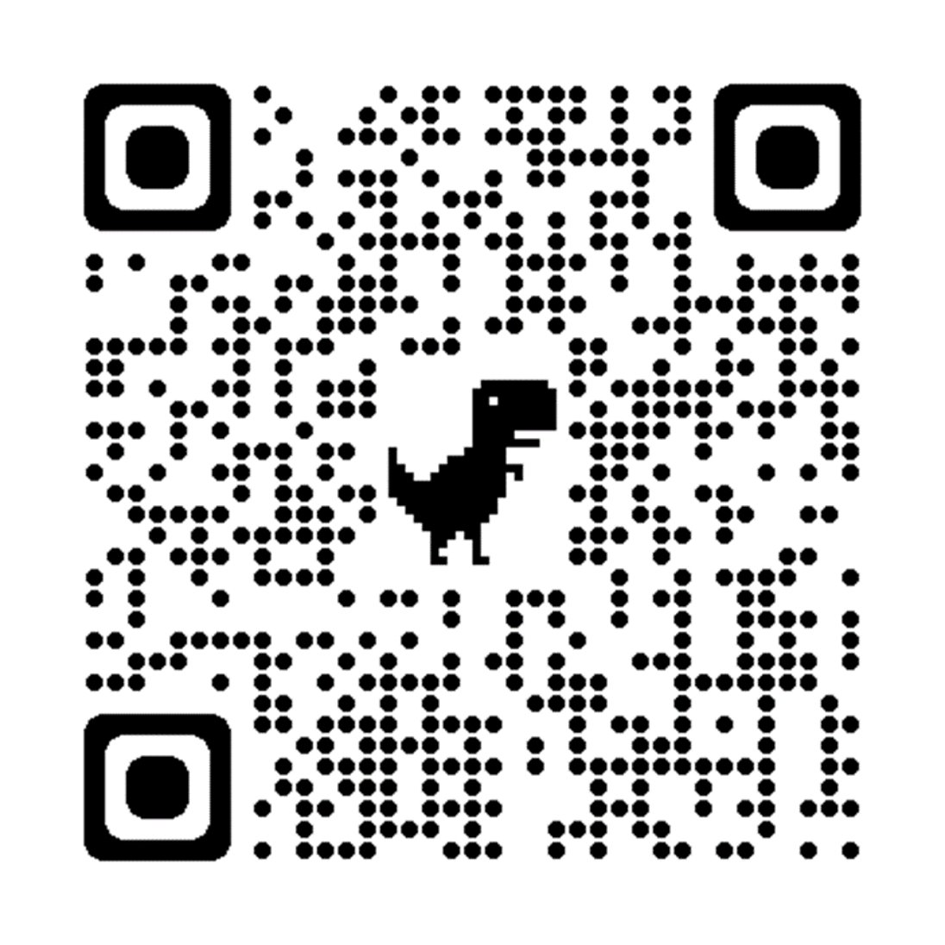
Questions…

Slide 3
Trends in Collections
Notes:
Joe
Welcome! We all hope you are as happy as we are to be part of the first, in person FAST Compliance Conference since February of 2020. A lot has changed since then, and we have a lot to talk about.
As we began to prepare for this session and discussed potential topics, we quickly realized that there is a lot going on in revenue agencies these days. Revenue agencies, as well as Government agencies in general, are reeling from the loss of staff and the inability to attract and retain staff. Unfortunately, it does not appear that there will be any relief from these staffing challenges any time soon.
For those of us working to optimize the collection of delinquent taxes, we have the additional challenge of the economic disparity resulting from COVID and its unequal financial impact on businesses and individuals – some prospered, others did not.
In response to these challenges, agencies have increased their focus on self-service, automation, and leveraging data to work smarter. This is especially important in Collections.
So, for today’s session, want to provide examples of agencies doing things differently to address longstanding challenges.

Slide 4
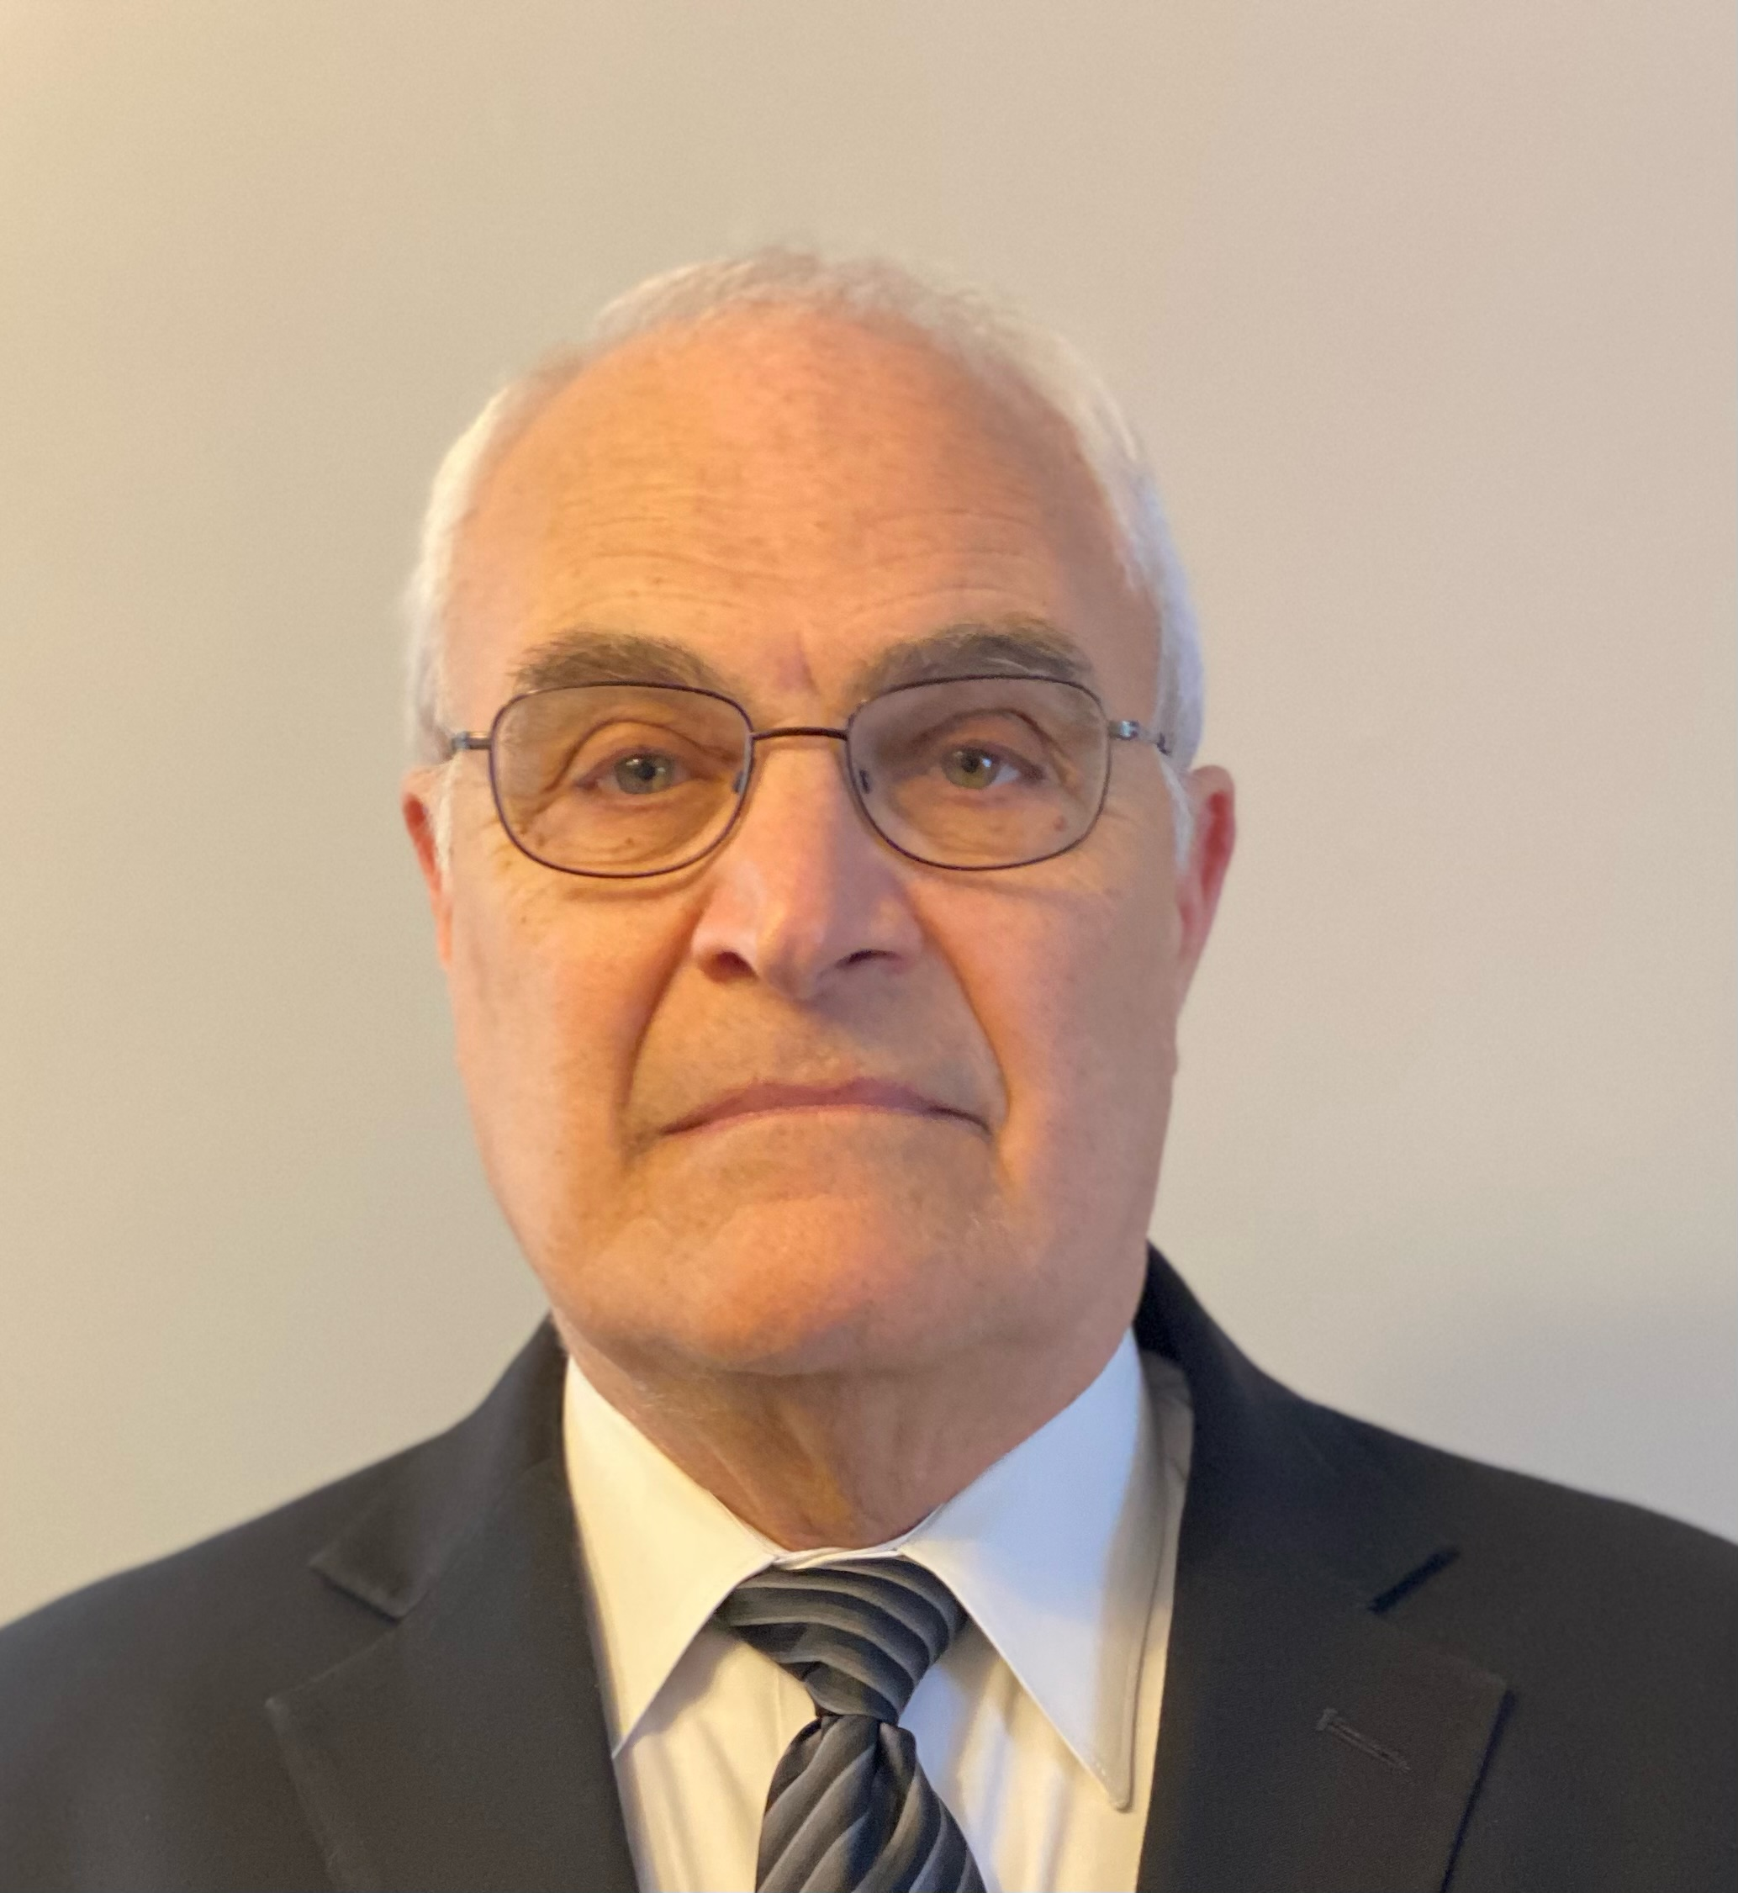
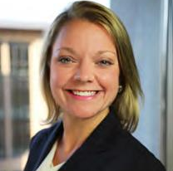
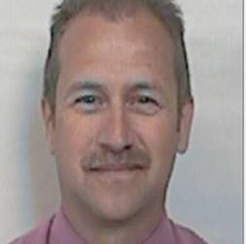
Introductions: Collections Breakout
Joe Milack
Sarah Meyers
Sara Westly
Brian Smith
Steven Hayes
Dale Simpson
Notes:
Sarah Introduce panel.
After introduction Sarah M. ask Sara W.
Can you speak to the changes in approach to collections over the last couple of years?

Slide 5
Equitable Collections in Minnesota
Notes:
You issued wage garnishments in the past, how is what you are doing now different?
What has the impact been?
Has this prompted rethinking how you use other collection actions?

Slide 6
Our Response to COVID-19
We stopped:
Issuing levies and subpoenas
Revoking professional license revocations
Revoking sales tax permits
Completing field work and walk-ins

Slide 7
Dollars Collected and Debts Closed
Year | Dollars Collected from Billing and Collections | Debts Closed
2019 | $369,770,102.01 | 217,238
2020 | $348,623,788.06 | 191,584
2021 | $347,196,602.01 | 197,869
Notes:
One message per slide
Too many messages on one slide are distracting and confusing for an audience
Title should reflect content of the slide
The title should be a quick indication of what to expect on that particular slide. Your titles should almost be able to be printed as a table of contents.

Slide 8
Payment Agreements
Pre-pandemic
Sent financial statement if the agreement will not be resolved in 36 months.
Now
Gather financial information while communicating with customer. Financial statement if expenses are above federal standard.

Slide 9
Payment Agreement Defaults
6-Month Default
Year Created | Payment Plan Count | Defaults | Default Rate
2022 | 19,341 | 526 | 2.72%
2021 | 51,432 | 3,504 | 6.81%
2020 | 58,500 | 4,565 | 7.80%
2019 | 84,715 | 7,393 | 8.73%
2108 | 84,875 | 7,661 | 9.03%
2017 | 78,399 | 6,930 | 8.84%
2016 | 76,096 | 6,768 | 8.89%
1-Year Default
Year Created | Payment Plan Count | Defaults | Default Rate
2022 | 19,334 | 526 | 2.72%
2021 | 51,432 | 4,417 | 8.59%
2020 | 58,500 | 5,920 | 10.12%
2019 | 84,715 | 9,651 | 11.39%
2108 | 84,875 | 10,001 | 11.78%
2017 | 78,399 | 9,069 | 11.57%
2016 | 76,096 | 8,874 | 11.66%
Notes:
Font no smaller than 24pt
If your audience can’t see it, they can’t understand it.
4 lines, 5 words per line or 5 lines, 4 words per line
You don’t need more than this to get the message of the slide across. If you need more words, you need more slides.
~20 - 30 words per slide
Any more will take your audience too long to read. They aren’t listening to you when they’re reading.

Slide 10
Levy Reductions
Wage Levy
Year | Issued | Reduced | Reduction Rate
2022 | 8,256 | 191 | 2.31%
2021 | 1,412 | 70 | 4.96%
2020 | 15,635 | 578 | 3.70%
2019 | 79,790 | 3,126 | 3.92%
2018 | 71,940 | 2,780 | 3.86%
2017 | 66,278 | 2,758 | 4.16%
2016 | 60,346 | 2,701 | 4.48%
Bank Levy
Year | Issued | Reduced | Reduction Rate
2022 | 4,481 | 48 | 1.07%
2021 | 652 | 18 | 2.76%
2020 | 13,334 | 166 | 1.24%
2019 | 73,462 | 960 | 1.31%
2018 | 73,330 | 911 | 1.24%
2017 | 74,197 | 1,020 | 1.37%
2016 | 64,469 | 817 | 1.27%
Notes:
The speaker just read slides to us
Too many speakers don’t use the notes. They rely on the slide to be their script.
Text was full sentences
Just a few words to get the meaning across are enough. Busy slides with too many words pull attention away from the speaker
Text was too small
If I can’t read what’s on the slide, I won’t remember it.
The visuals were too complex
Simple = easily understood.

Slide 11
Recommendations
Offset Likely—Individual Only
Self-Cure—Individual Only
Wage Levy—Individual Only
Bank Levy
Lien Review

Slide 12
Customer Service Recommendations
FDS Best Phone
Missing Payments
Payment Plan Renegotiate

Slide 13
Work Item Inventory
Year | Average Collection Work Item Inventory
2019 | 95,301
2020 | 106,073
2021 | 137,982
Notes:
A PowerPoint is the picture to go with your spoken words
Think of it as the picture part of the book.
Use key words and images to drive your point
If you have too much on your slide, the audience will simply read the slide, instead of paying attention to you.
Do not write a script
Unless you do it here, in the notes section. That’s what notes are for, to remind you how to expand on your slide.
Do not think of it as a handout
A PowerPoint is not meant to be a handout. If you need to create a handout, do so.

Slide 14
Wage Levy Approach in South Carolina
Notes:
You issued wage garnishments in the past, how is what you are doing now different?
What has the impact been?
Has this prompted rethinking how you use other collection actions?

Slide 15
Evolving Wage Levy Enforcement
What we have done:
Establish other options to initiate contact with taxpayer
Notice of Payment Plan Eligibility
Contact Information Needed
Improve Selection of Wage Levy Candidates
Self Cure & Offset Likely
Scoring of levy sources
Ability to focus levies to certain types of debts
Completed E-Levy Project w/ADP

Slide 16
Evolving Wage Levy Enforcement
What we have done:
Improve Communications
Clear about Reduction Requirements
Redirect to Email
Improve Phone Tree
Removal of Phone Number
Mask agent’s name
Wage Levy Reduction Web Request w/upload
Prompts within Assistant

Slide 17
Evolving Wage Levy Enforcement
In progress:
Improve Communications
Build a dedicated webpage for Levy Information
Update Assistant for consistency
Outreach and reeducate our Levy Sources
Research and resolve Levy Sources that are not complying
Pilot of main phone line turn off – Summer 2023
Payment Plans Eligibility Notice w/direct warning of wage levy
Includes source name and date if payment plan not in place

Slide 18
Out of State Collections in Pennsylvania

Slide 19
Out of State Collections in Pennsylvania
Cases Receiving Final Warning Letter | Active DOR Cases | Closed DOR Cases | Active Vendor Cases | Closed Vendor Cases | Total Liability of All Cases | Total Liability of Cases Referred to Vendor | DOR Collections | Vendor Collections | Total Program Collections
480 | 73 | 101 | 194 | 112 | $ 91,414,900.00 | $ 44,293,541.79 | $ 10,803,564.29 | $ 9,068,809.51 | $ 19,872,373.80
As of September 30, 2022

Slide 20
Maximizing OCAs in Illinois

Slide 21
Contact Information
Sarah Meyers
FAST Director
smeyers@gentax.com
Joseph Milack
FAST Client Support
jmilack@gentax.com
Sara Westly
Minnesota Department of Revenue
Collection Division Director
Sara.westly@state.mn.us
Brian Smith
South Carolina Department of Revenue
Collection Administrator
Brian.smith@dor.sc.gov
Dale Simpson
Pennsylvania Department of Revenue
Deputy Secretary Compliance and Collections
dsimpson@pa.gov
Steven Hayes
Illinois Department Of Revenue
Program Administrator
Steven.hayes@Illinois.gov

Slide 22
Notes:
Poll Title: Do not modify the notes in this section to avoid tampering with the Poll Everywhere activity. More info at polleverywhere.com/support Collections Breakout Questions https://www.polleverywhere.com/discourses/M5OWDgL7pSzE7gthVHfps

